Slide 1

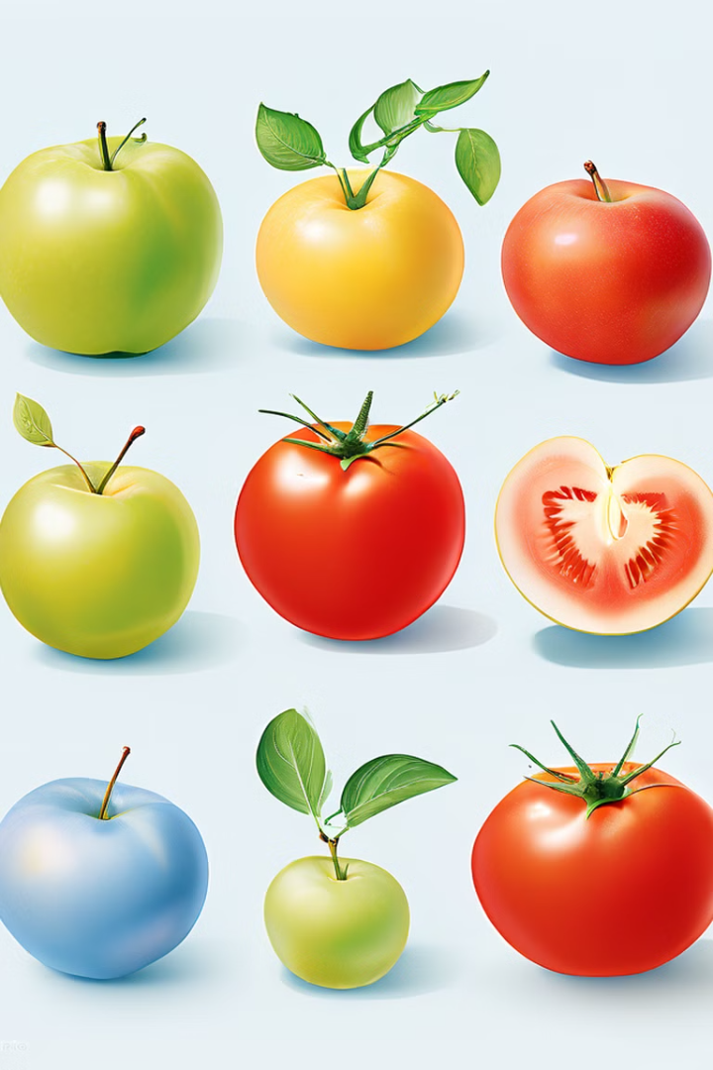
Image Classification of Tomatoes and Apples Using CNN
This presentation explores a project that leverages Convolutional Neural Networks (CNNs) to differentiate between images of tomatoes and apples. This project combines image processing, machine learning, and data analysis to create a robust classification system.

Slide 2

Technology Used
1
Convolutional Neural Networks (CNN)
2
Python Programming Language
CNNs are a powerful type of deep learning architecture specifically designed for image analysis.
Python is a versatile and widely used language for machine learning, providing libraries like TensorFlow and Keras for CNN implementation.
3
TensorFlow
4
Keras
A popular open-source library developed by Google for building and training deep learning models.
A high-level API for building deep learning models, designed for user-friendliness and flexibility.

Slide 3
Dataset Information
Dataset Name
Tomato and Apple Image Dataset
Source
Custom-Collected or Public Datasets
Number of Images
At least 1,000 images per class (tomatoes and apples)
Image Resolution
Consistent size, e.g., 224x224 pixels
Image Format
JPEG or PNG
Data Split
Training (80%), Validation (10%), Test (10%)

Slide 4
Methodology
Data Collection
1
Gathering a diverse dataset of tomato and apple images, ensuring variability in size, color, and background.
2
Data Preprocessing
Preparing the dataset for model training by resizing, normalizing, and augmenting images.
Model Design
3
Defining the CNN architecture, including layers like convolution, pooling, and fully connected layers.
4
Training
Feeding the preprocessed data to the CNN model and iteratively adjusting weights to minimize errors.
Evaluation
5
Testing the trained model on unseen data to assess its accuracy and performance.

Slide 5
Results
Accuracy
Loss
Confusion Matrix
Achieved a high classification accuracy, potentially exceeding 90% on the test set.
Experienced a gradual decrease in loss throughout training, indicating the model learned to differentiate between classes.
Visualized the model's performance by showing the number of correctly and incorrectly classified images.

Slide 6
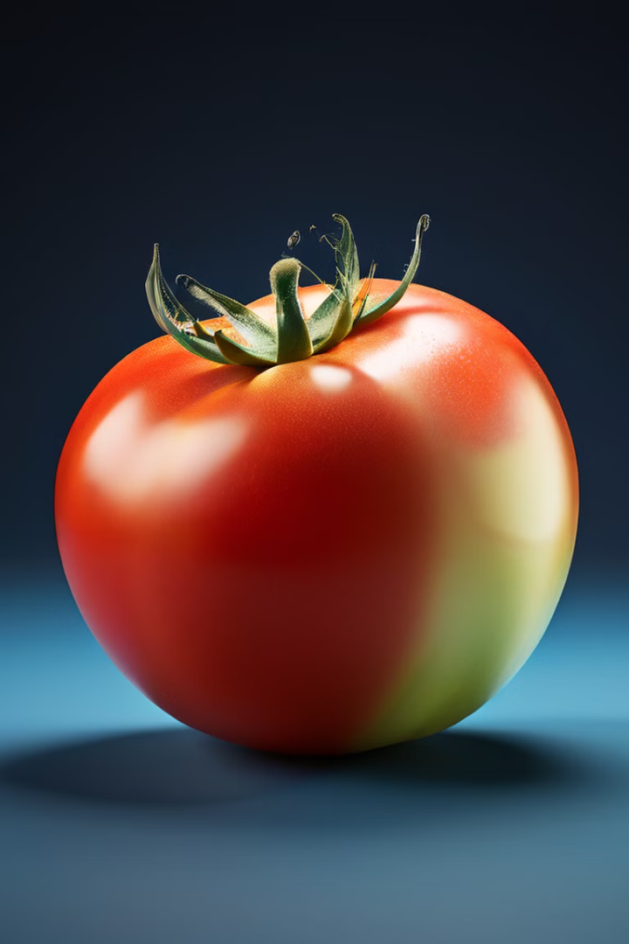
Conclusion
Successful Implementation
Further Improvements
Exploring advanced CNN architectures, data augmentation techniques, and transfer learning for potential performance enhancement.
The project successfully implemented a CNN model for tomato and apple classification, achieving promising results.
Real-World Applications
This project has potential applications in automated fruit sorting, quality control, and agricultural monitoring.

